Slide 1
DDSAnalytics
Your Solid Strength for Power
ChemicalRepo
Workforce Analysis
Gabe Gonzales Jeremy Simpson Kari Theobald Shane Weinstock
April 16, 2019
Notes:
Good Afternoon : I am Kari Theobald a Data Scientist here at DDSAnalytics. I am here with my fellow Data Scientist Gabe G , Jeremy S. and Shane W.
We are here this evening to present to you information about ChemicalRepo.
Since DDSAnalytics is a Fortune 1000 company we are working to contribute to the Company image of “your Solid Strength for Power.”
We have formalized some research on the client ChemicalRepo and believe there are contributing reasons for attrition with their company.
We have also found some interesting facts within ChemicalRepo’s employee data (beyond the reason for attrition).
We believe this will show DDSAnalytics unique method of using Data Scientist to dig in to the available data and ultimately bring Power to ChemicalRepo.

Slide 2
KARI
Business Objective
Data Sourced
Methodology
JEREMY
Hypothesis
Attrition
Percentages
SHANE
Age to Income Ratio
Commute
Department Titles
GABE
Life Satisfaction Rate
Recommendation
Improvements
OBJECTIVE
Notes:
Each Data Scientist will demonstrate to you key point and discoveries found within the data.
DS Jeremy will discuss with you our hypothesis and other interesting facts and percentages.
DS Shane will follow with Graphs about how Age to income correlate along with some facts that can contribute to attrition.
DS Gabe will show you some other interesting facts found in the data of ChemicalRepo.
He will also advise you of what is recommended as a pitch to ChemicalRepo for improvments.

Slide 3
OBJECTIVE
What causes voluntary/involuntary attrition?
What adjustment can be made in workforce planning at ChemicalRepo?
SOURCE OF DATA
Human Resource supplied employee information for ChemicalRepo.
Job applications.
Exit interviews.
GOAL
Reasonable Summation for Attrition.
Notes:
So we were giving an objective from the management in DDSAnalytics to determine
What caused vol / invol attrition?
What adjustment can be made in the workforce planning at ChemcialRepo.
So we were given data from the HR department from ChemcialRepo about current and former employees.
The information was obtained through job applications and Exit interviews.
We set out a Goal to deep dive into the companies employee data and find a reaonable summation for attrition and what could be improved upon within the workforce at ChemcialREpo. We had over 35 variables within the data and 1470 rows of information. Ranging from did they travel, to where they married.

Slide 4
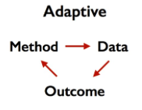
Adaptive Methodology
“We adapt our method to the data” [1]
Given the SCOPE of the Data. [2]
DESIGN
BUILD CODE
TEST
CHECK RESULTS / REDESIGN
RECOMMEND RESULTS / DEPLOY
Notes:
In our study we decided to use the Adaptive Methodology.
We were given data and we are applying a method to find an outcome. We evaluated the Scope of the DATA, We disgned an R code, tested the data in the code, checked the results and redesigned the code to find more pertante results. We are ready to bring to you a recommend so you can present to ChemicalRepo a deployment.

Slide 5

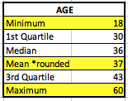


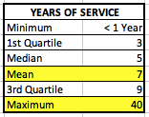
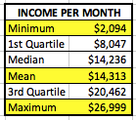
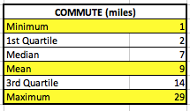
CHEMICALREPO EMPLOYEES
Notes:
Let’s take a look of some relevant information within the ChemcialRepo Employee data.
1st, we have 588 Female, 882 Males working for the company. So, we are working with a data set of 1470 employees.
We also conclude all employees are over the age of 18. The employee answered affirmatively that they were over 18 and we affirmed there no employees below this age in our data.
Looking on .. The Average Years of Service for an employee working in ChemicalRepo is 7 years.
We also show some employees have some incredible longevity of 40 years in this company.
We also reviewed the lowest monthly income at $2,094.
We reached out to ChemicalREpo and confirmed this to be accurate and it is not just a base salary and the employee forgot to add commission.
So - the monthly income is both commission and base salary or simply hourly wage or salary income.
Last - let’s look at the commute. The longest commute is 29 miles for some employees and the shortest commuter is 1 mile. This seems normal given the area and location for ChemicalRepo and the Avg commute to the office is 9 miles.

Slide 6
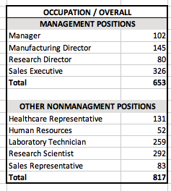
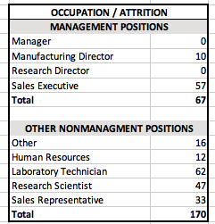
MANAGEMENT VS. NON-MANAGEMENT
Notes:
We looked into the number of managers vs non management.
We would like to highlight there are 653 Management positions and 817 Non Management positions.
This means ChemicalRepo employees data contains 44.4% management positions. Keep in mind this is attrition and non attrition employees.
We can see only 10 mfg directors have attritioned and 57 sales executives have atritioned out of the company..

Slide 7
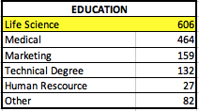
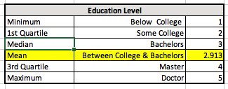
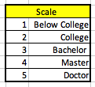
EDUCATION IN CHEMICALREPO
Notes:
Before we go to Jeremy to discuss with some other important facts about attrirtion. We would like to show you ChemicalRepo’s Education level in the company The average employee holds Some College to a Bachelor's degree. And the dominating field of study is Life Science majors.
Now I would like to hand this over to Jeremy for some very cool facts about ChemicalRepo.

Slide 8
Hypothesis
We hypothesize that the following are the major contributing factors to attrition within the company:
Sales Department
Overall commute distance to the workplace
Employee Age

Slide 9
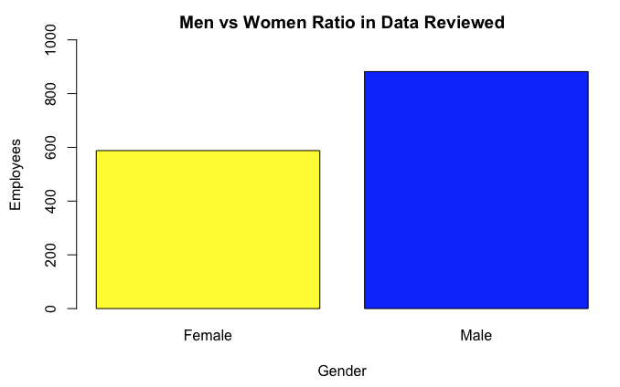
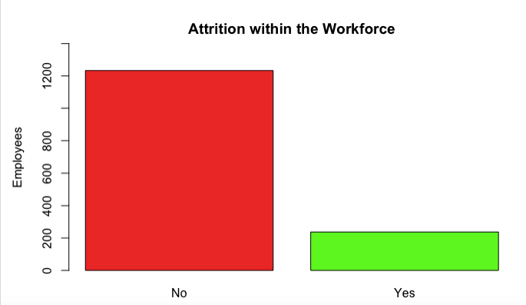
Evaluation
Tell me the percentage? Out of 1470 employees. 60% of the workforce Male (882) and 40% Female (558). The Attrition rate is at 16% with 237 employees leaving the company.
882
558
84%
16%
Notes:
We do not know how old this data is from ChemicalRepo. So the attrition rate is 16% but we cannot tell you how fast this attrition is occuring.
No Start and End Date of Data Sourced.

Slide 10
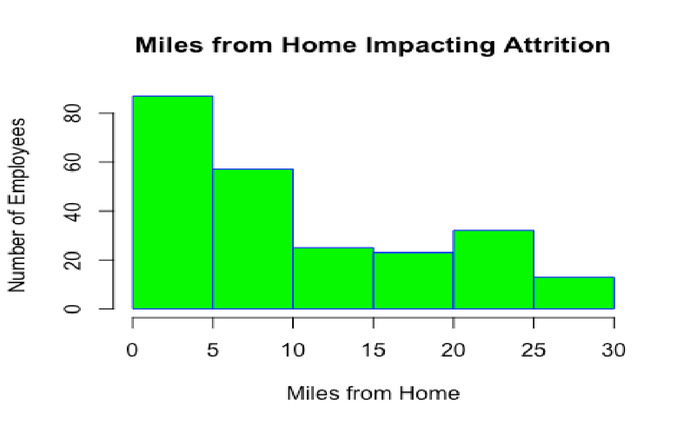
Attrition Variables/Cause
Commute Distance

Slide 11
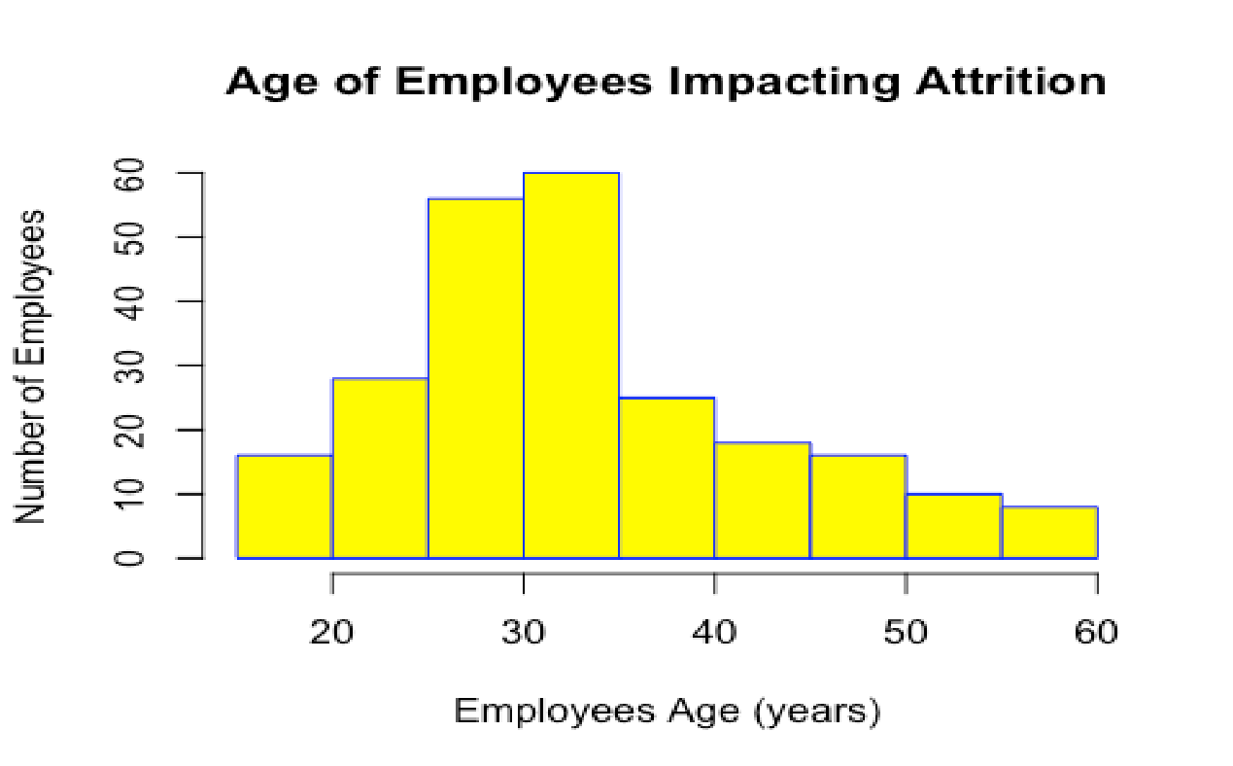
Attrition Variables/Cause
Employee Age

Slide 12
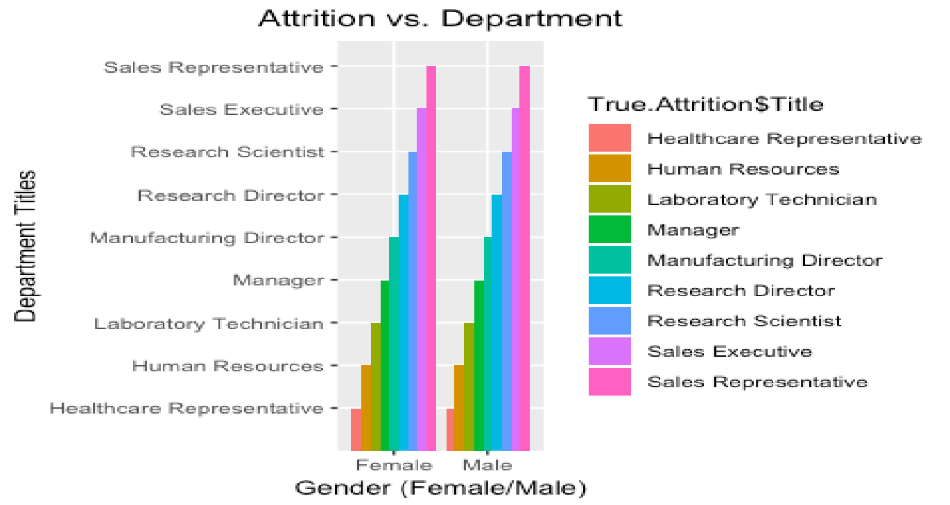
Attrition Variables/Cause
Sales Department

Slide 13
Evaluation / Results
Evaluation :
For our comparisons we wanted to compare men to women within the company as we noticed such a large disparity in the number of each gender at ChemicalPro.
With a male dominant workforce, we thought there might be different preferences between men and women that would affect job satisfaction.

Slide 14
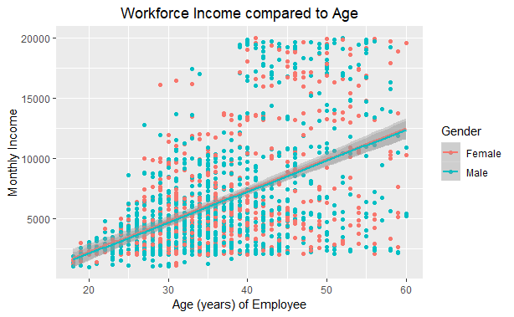
Is there a correlation or relationship between age and income?
Yes.
The data provided shows about a 49% relationship between age and income.
This relationship is moderately strong and positive.
We observed that with every year of age change, holding all other variables constant, we’d estimate a $256.57 change in monthly income.

Slide 15
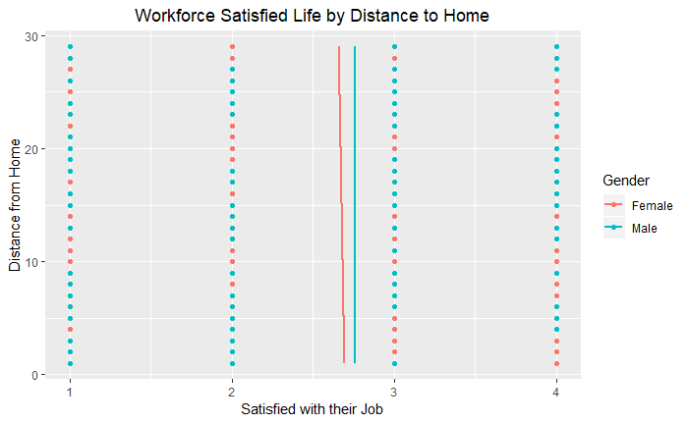
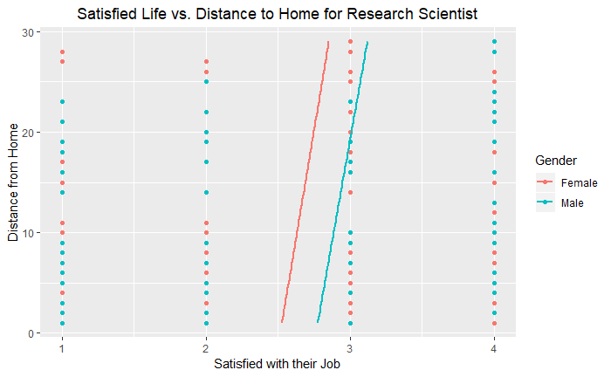
Commute Distance
The overall workforce grew more satisfied the further away from work the lived.
The Research Scientist was about 20 times more satisfied than the general workforce with each mile (all other variables held constant) that they lived from home.

Slide 16
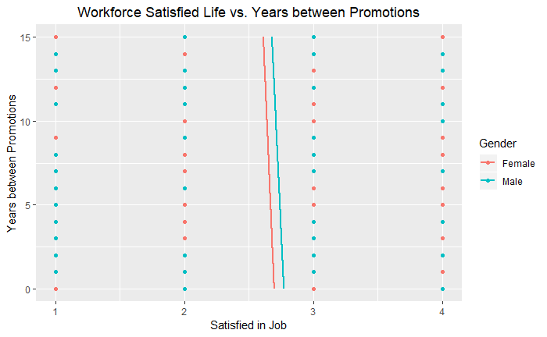
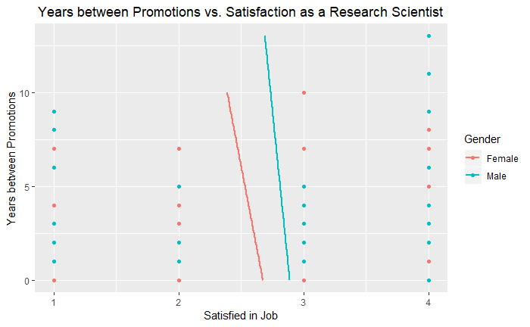
How do promotions affect attrition?
The overall workforce showed an expected relationship of becoming less satisfied with their jobs when the length of time increased between promotions.
This rate was even greater overall for both genders combined for the Research Scientist.

Slide 17
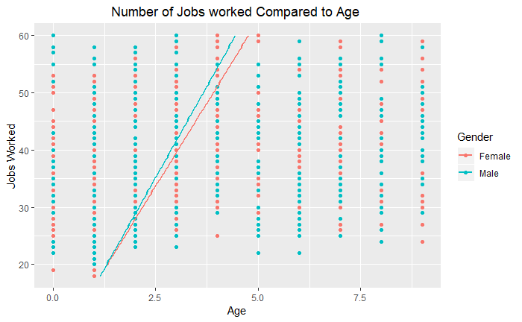
Do the number of jobs increase as age increases?
This may be a basic or obvious correlation, but it does shed some light on our assumptions for our conclusions and future assumptions.
With all other variables held constant, we found that for every 4 or 5 years of age an employee would hold a new job.
This could also be said as though an employee working with ChemicalPro would generally hold either a new job or position every 4 or 5 years.

Slide 18
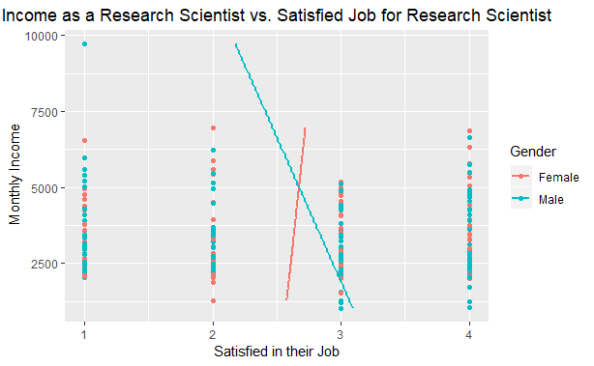
Does an increase in salary yield an increase in job satisfaction?
This was an interesting relationship that could have several confounding variables.
What we observed was that females were more satisfied and driven by the income they received, however the males were not.
The more a male made as a Research Scientist, the less satisfied he was in his job.
The Research Scientist starts their career as “Highly Satisfied” with the corresponding salary to entry, however as they increase past $5,000/mo it’s observed that their job satisfaction decreases.
Men making almost $10,000/mo are at an even lower satisfaction rate.

Slide 19
Summary / Result
Insights? (Life Satisfaction)
Those that live farther from work are more satisfied
Men are slightly more satisfied w/ work as they get older - also if single
Those that are married are more satisfied than those who are not
Male Research Scientists become less satisfied as income increases while female Research Scientists become more satisfied as income increases
Recommendations
Reduce the sales team to those below the age of 25 or increase team beyond 35 years of age
Increase the hiring age beyond 35 y.o.
Hire employees with at least 8 jobs before the age of 45
Look for employees w/ a commute >10 miles from office
Improvements
Know specifics about when data was collected and over what period of time. Older data is less relevant in today’s ever-changing job market
Close ===
Questions?

Slide 20
References
Hardt, Moritz. Adaptive Data Analysis, Moody Rd. http://blog.mrtz.org/2015/12/14/adaptive-data-analysis.html. Accessed 14 April 2019.
Sanchez, Felipe. Data Science projects management methodologies. Towards Data Science. https://towardsdatascience.com/data-sciencce-projects-management-methodologies-54339c9d5e5a. Accessed 14 April 2019.

